Slide 1
Pixel Colors
Mack 2021

Slide 2
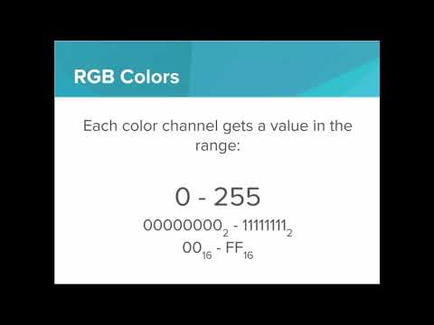
We learn how to make pixels with color using the RGB color encoding scheme

Slide 3
What are the 3 color channels that make up a pixel according to the RGB color scheme?
Notes:
🍐 This is a Pear Deck Multiple Choice Slide. Your current options are: A: Red, Green, and Blue, B: Red, Blue, and Yellow, C: White, Black, and Gray, D: Cyan, Magenta, and Yellow,
🍐 To edit the type of question or choices, go back to the "Ask Students a Question" in the Pear Deck sidebar.
A

Slide 4
What is the range of values (expressed in decimal) that each color channel can have?
1₁₀ - 256₁₀
0₁₀ - 255₁₀
-128₁₀ - 127₁₀
0₁₀ - 127₁₀
Notes:
🍐 This is a Pear Deck Multiple Choice Slide. Your current options are: A: A, B: B, C: C, D: D,
🍐 To edit the type of question or choices, go back to the "Ask Students a Question" in the Pear Deck sidebar.
B

Slide 5




Which of the following pixels has a color value of #ff0000 (expressed in hexadecimal)
Notes:
🍐 This is a Pear Deck Multiple Choice Slide. Your current options are: A: (White Pixel), B: (Blue Pixel), C: (Green Pixel), D: (Red Pixel),
🍐 To edit the type of question or choices, go back to the "Ask Students a Question" in the Pear Deck sidebar.
D

Slide 6
Practice: Exploring RGB
Colors have a red, blue, and green component between 0 and 255. When representing a color, you choose a value for each of red, green, and blue.
For example, to display a red pixel, you would use this color:
255, 0, 0
This is represented in hexadecimal as
FF0000
Green is represented as 00FF00.
Your task:
Try adding a blue pixel to the screen

Slide 7
Practice: Making Yellow
So we’ve seen how to represent the 3 standard colors:
Red:
FF0000 (hexadecimal)
11111111 00000000 00000000 (binary)
Green:
00FF00 (hexadecimal)
00000000 11111111 00000000 (binary)
Blue:
0000FF (hexadecimal)
00000000 00000000 11111111 (binary)
Your task:
Your challenge in this problem is to make the color yellow.
Which color channels are turned “on” and which are turned “off” to represent yellow?
Why do you think that’s the case?

Slide 8
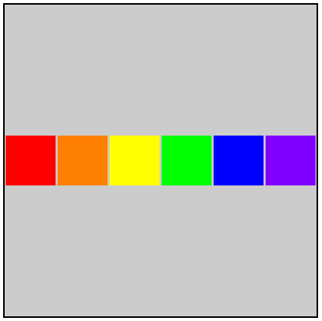
Practice: Pixel Rainbow
The goal of this exercise is to make a 6 pixel rainbow with Hex Values.

